Slide 1
Optimizing Complex Structures
Alberto TONDA
UMR 518 MIA-PS, INRAE, AgroParisTech, Université Paris-Saclay UAR 3611, Institut des Systèmes Complexes de Paris Île-de-France

Slide 2
Outline
Genetic Programming
Linear Genetic Programming
Grammatical Evolution
Examples

Slide 3
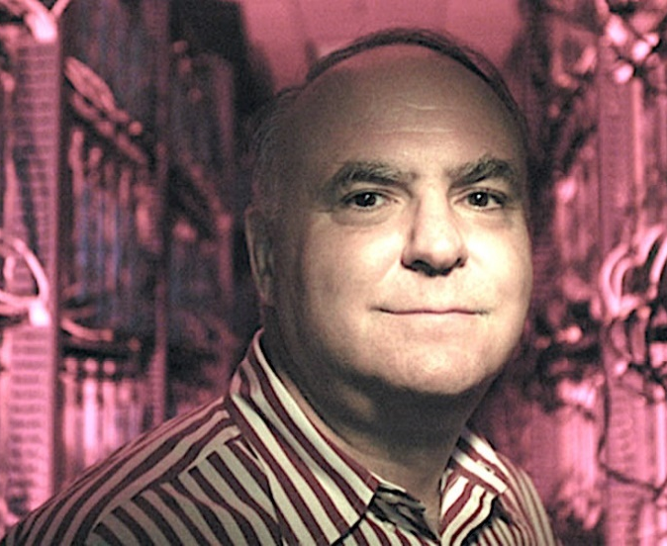
Genetic Programming
Genetic Programming
John Koza, 1992
Extend EAs to anything
Focus on computer programs
Internal representation
Binary trees
Specialized mutations and crossovers
Search space difficult to characterize (or even visualize!)

Slide 4

Genetic Programming
General idea: OPTIMIZE ALL THE THINGS with EAs
If you can describe a candidate solution to a problem…
…and variators (e.g. mutations, crossovers)…
…and you can define a fitness/objective function…
…EAs can explore the space of all possible solutions!
It worked for life on Earth!
DNA is pretty complicated
Genome doesn’t need to be just numbers
Notes:
It does not matter if it’s a tree, if it’s a graph, or if it’s something else entirely. You can describe a solution, you can slightly modify the solutions, you can define a function that describes the goodness of a solution…and you can explore the space of all possible solutions using an evolutionary algorithm

Slide 5
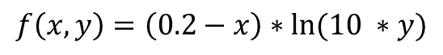
Genetic Programming
*
Operators: +, -, *, /, ln…
Terminals: reals, ints, vars, …
-
ln
0.2
x
*
10
y
$$f\left(x,y\right)=\left(0.2−x\right)∗ln⁡(10 ∗y)$$
Notes:
A first distinctions in GP is between nodes that can appear in the middle of a tree, and nodes that can only appear on leaves.

Slide 6
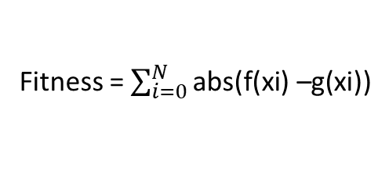
Symbolic Regression
*
f(x) = [0.2 – (x/42)] * ln(x)
Fitness = $\sum_{i=0}^{N}{\text{abs}\text{(}\text{f}\text{(}\text{xi}\text{) –}\text{g}\text{(}\text{xi}\text{))}}$
-
ln
y
y
0.2
/
*
x
+
1
x
40
2
x
x
Genotype/Internal representation
Phenotype
Fitness/Objective function
Notes:
Here I used the sum of the absolute errors, but it could be the mean squared error or other metrics.

Slide 7
Symbolic Regression
*
f(x) = [0.2 – (x/42)] * ln(x)
*
-
ln
ln
-
y
0.2
/
*
x
0.2
/
x
+
1
x
x
42
40
2
x
Genotype 1
Phenotype
Genotype 2
Notes:
Here you could say; ok, but then two trees with different genotype and the same phenotype will have the same fitness! Which is true for symbolic regression, but not for all GP applications.

Slide 8
Genetic Programming
*
Operators: +, -, *, /, ln…
Terminals: reals, ints, vars, …
-
ln
0.2
x
*
10
y
$$f\left(x,y\right)=\left(0.2−x\right)∗ln⁡(10 ∗y)$$
Notes:
That is why I will use this greek letters.

Slide 9
Genetic Programming
α
Operators: α, β, γ, ζ, λ, π, ς, …
Terminals: δ, ε, η, θ, ρ, σ, τ, …
β
γ
δ
ε
ζ
η
θ

Slide 10
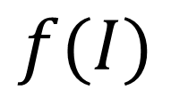
Genetic Programming
α
I = α(
β(δ, ε),
γ( ζ(η, θ) )
)
β
γ
$$f(I)$$
δ
ε
ζ
η
θ
Genotype
Phenotype
Fitness
Notes:
Here I am using Greek letters (that I cannot pronounce properly) to represent the fact that a node could contain anything. It could be instructions for a program, mathematical operators, the description of a neural network, whatever. It is interesting to notice that in genetic programming, we start to have a true difference between genotype and phenotype. There is an intermediate representation before fitness computation

Slide 11
Genetic Programming
How to explore this complex search space?

Slide 12
Genetic Programming
Mutation(s)
α
β
γ
δ
ε
ζ
η
θ
Notes:
Here stop and ask if they can think about mutations that could work on this kind of structure

Slide 13
Genetic Programming
Mutation(s)
α
POINT MUTATION
β
γ
δ
ε
ζ
η
θ

Slide 14
Genetic Programming
Mutation(s)
α
POINT MUTATION
β
γ
δ
ε
λ
η
θ

Slide 15
Genetic Programming
Mutation(s)
α
SUBTREE MUTATION
β
γ
δ
ε
ζ
η
θ

Slide 16
Genetic Programming
Mutation(s)
α
SUBTREE MUTATION
β
γ
δ
ε
π
ρ
ς
σ
τ

Slide 17
Genetic Programming
Mutation(s)
α
HOIST MUTATION
β
γ
δ
ε
ζ
η
θ

Slide 18
Genetic Programming
Mutation(s)
α
HOIST MUTATION
β
γ
δ
ε
θ

Slide 19
Genetic Programming
Crossover(s)

Slide 20
Genetic Programming
Crossover(s)

Slide 21
Genetic Programming
Crossover(s)

Slide 22
Genetic programming: issues
“Bloating”
As the optimization proceeds, trees tend to become bigger
With no positive impact on objective function value
Solution: add term to objective function to penalize size
Solution: use a multi-objective approach (minimize size)
Analyzing this in terms of ML, it could be overfitting
Bigger model, more parameters, easier to fit a function
For bigger models also easier to “memorize” training set

Slide 23

Genetic Programming
What are we doing?
Blending optimization and machine learning?
If your candidate solution is a model…
…then you are (arguably) doing machine learning!
Terminology is still in development
Researchers in GP getting closer to the ML community

Slide 24
Linear Genetic Programming
Evolving linear graphs
Used for evolving computer programs
Backward/forward arcs interpreted as jumps
ADD AX, BX
label1: ADD AX, BX
JLE label2
MUL AX, 4
label2: SUB CX, 20
JMP label1
JLE
MUL AX, 4
SUB CX, 20
JMP

Slide 25
Linear Genetic Programming
Evolving linear graphs
Used for evolving computer programs
Backward/forward arcs interpreted as jumps
print(a)
while a < 100 :
print(a)
if a > b :
a += 1
else :
a -= 1
If a > b
a -= 1
a += 1
while a < 100

Slide 26


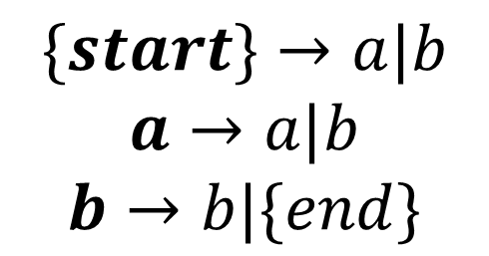
Grammatical Evolution
“Grammar” in computer science
Defines a way to generate/validate a sequence of symbols
Used to check syntax coherence of programming languages
Evolutionary algorithm generate candidate solutions w/ grammar
ab
$$\{start\}→a|b$$
$$a→a|b$$
$$b→b|\{end\}$$
aaaaaabbbbbbb
aba

Slide 27
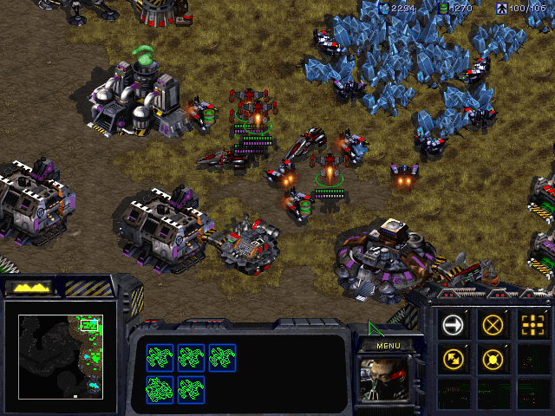
Example: Evolving AIs
Real-time strategy (RTS)
Planet Wars (Google)
StarCraft
Student StarCraft AI Tournament
Trade-off
ANNs are better
You can read GP trees

Slide 28
Example: Genetic Improvement
Automatic correction of software bugs
Individual: series of code modifications
Fitness/Objective function
A series of test cases
They still have to work
Comment line 52
Swap lines 3 and 22
Change variables lines 42 and 11
…

Slide 29
Example: Genetic Improvement
But does it really work?
Aren’t EAs introducing other bugs?
Aren’t HUMANS introducing other bugs?
In the end, you just need to be as good as the average programmer, and you save time
Still experimental
Langdon, William B. Genetically Improved Software, 2015
Justyna Petke and Saemundur O. Haraldsson and Mark Harman and William B. Langdon and David R. White and John R. Woodward. Genetic Improvement of Software: a Comprehensive Survey, 2017

Slide 30
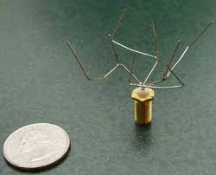
Example: ?

Slide 31
Example: Antennas
Design of antennas for satellite ST5 (2006)
Lots of constraints: weight, size, efficiency…
Genome/representation is a tree
Forward (length, radius)
Rotate_x (angle)
Rotate_y (angle)
Rotate_z (angle)
It worked!

Slide 32

Example: Robot Movement

Slide 33
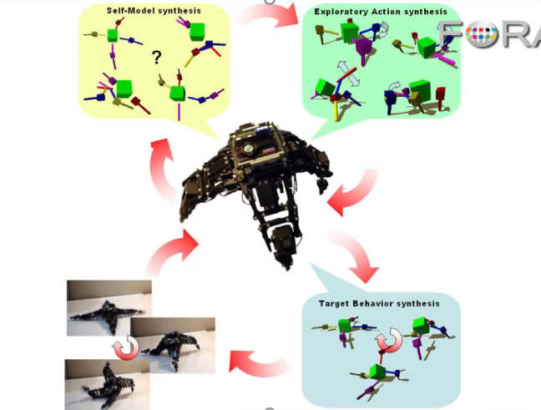
Hod Lipson mentioned something…
While speaking about the candidate models for the robot
He said “next, we are going to compare the models on the most discriminating movement”
Candidate models fit the data they have already seen
It make sense to test them on new data where they have different predictions
But how do we know what is the movement for which the models have the most different predictions?

Slide 34
He did not say! But we know…
It’s optimization!
You have a vast search space of possible movements
And an archive of candidate models
Search for the candidate movement that maximizes the difference in prediction between candidate models
Competitive Co-evolutionary Algorithms
Lipson and Schmidt, “Coevolving Fitness Models for Accelerating Evolution and Reducing Evaluations”, 2007
Lipson and Schmidt, “Coevolution of Fitness Predictors”, 2008

Slide 35
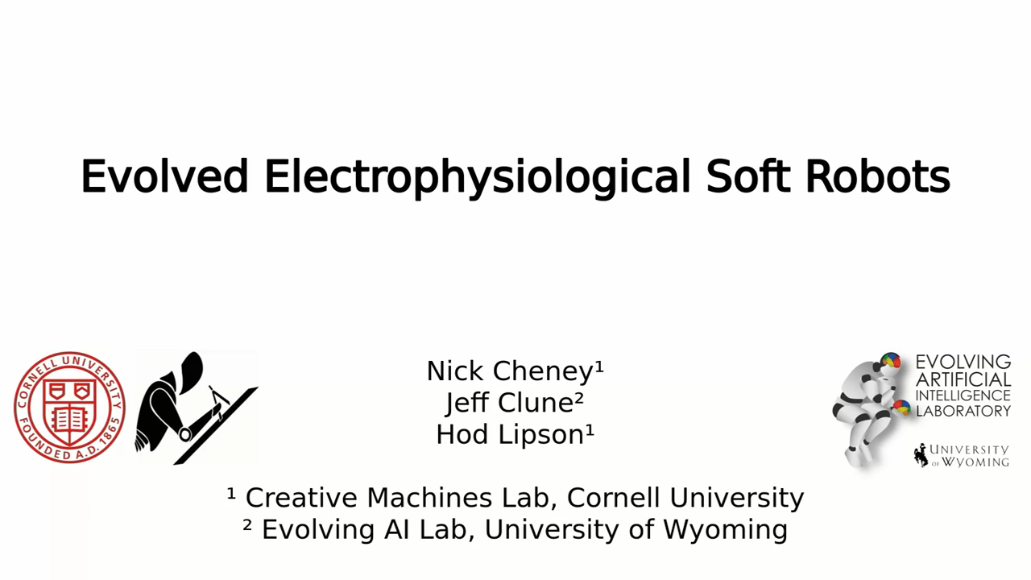
Example: Soft Robot Movement

Slide 36
Genetic Programming vs Generative NNs?
Generative neural networks
Learn from existing training samples (e.g. images or text)
Able to create high-quality results, fast inference (slow training)
Generalize poorly “out of distribution”
Genetic programming
Can create unique structures, never seen before
Needs an ad-hoc objective function to sample
Extremely slow (one whole run for one creation)
Human-interpretable (up to a certain limit)

Slide 37


Questions?
Bibliography - Koza, Genetic Programming, 1992 - Garcia-Sanchez et al., Towards Automatic StarCraft Strategy Generation Using Genetic Programming, 2015 - Lipson & Pollack, Automatic design and manufacture of robotic lifeforms, 2000
Images and video: unless otherwise stated, I stole them from the Internet. I hope they are not copyrighted, or that their use falls under the Fair Use clause, and if not, I am sorry. Please don’t sue me.

